Slide 1
Inferences
Playing the Educated Guessing Game
{Click mouse to continue}

Slide 2
What is an Inference?
An inference is an assumption that you make about something that you see, read, or experience.
It is based on all of the information that you have available at that time.
It is not necessarily a correct guess, but it is an educated one.
{Click mouse to continue}

Slide 3
Everyday Inferences
Here are some inferences that you probably make on a daily basis.
If your professor writes information on the board during a lecture
You infer that it is important information that you may need later.
If your son or daughter runs in the house holding their knee and crying
You infer that they have somehow hurt their knee.
You may not always be correct in your inferences, but they are assumptions that you make based on the given clues.
{Click mouse to continue}

Slide 4

Inferences: Take a Guess
You already know how to make everyday inferences!
Lets look at a few scenarios and infer about what is going on.
{Click mouse to continue}

Slide 5
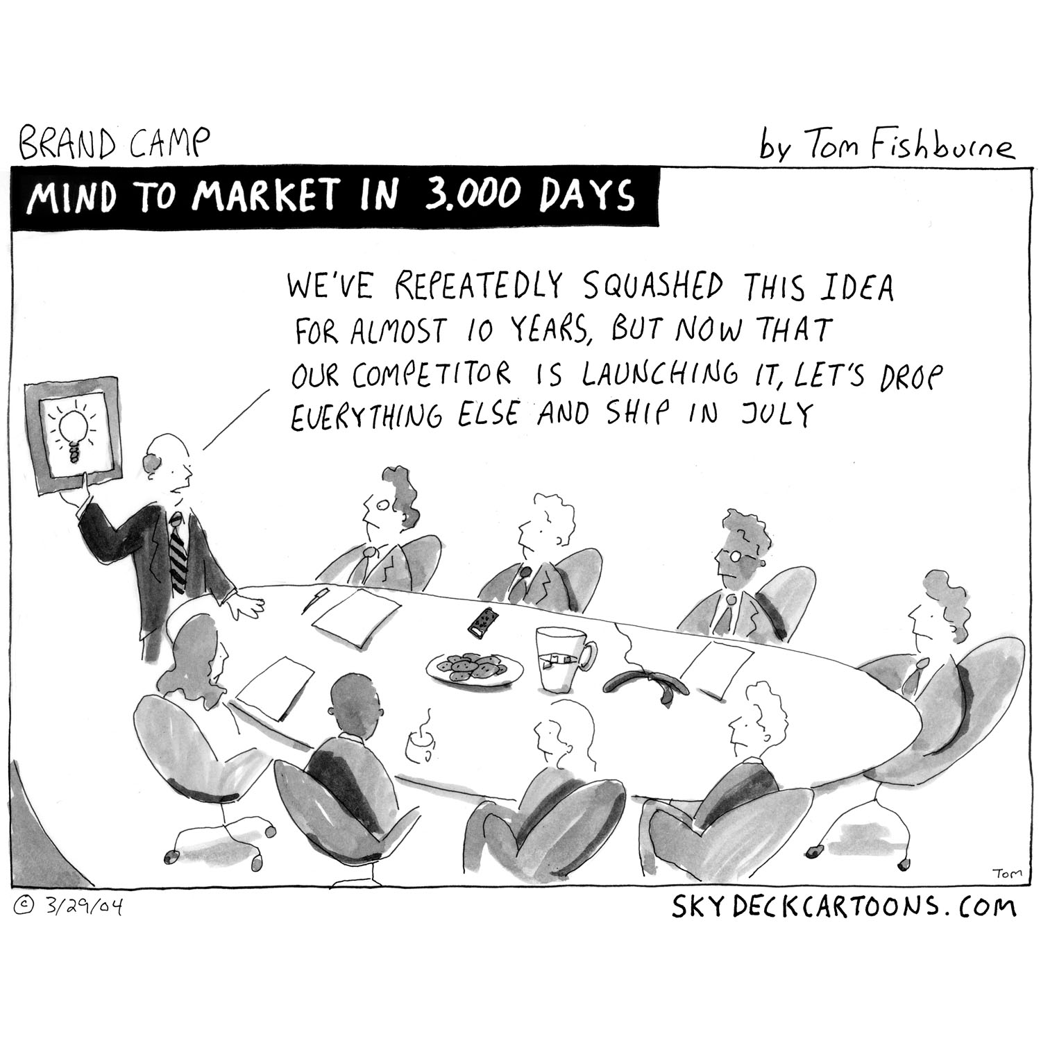
Inferences: Take Another Guess?
Where are they?
2. Who is the man standing in the front of the room?
3. Is this company on the cutting edge?
{Click mouse to continue}

Slide 6
Inferences: Take a Guess?
Lets look a little bit closer and evaluate your assumptions.
Who is the man standing in the front of the room?
Because he is in the front of the room standing we would infer that he is the boss.
The table and topic, reveal that they are in a corporate board room.
Where are they?
Is this company on the cutting edge?
We can infer by his dialogue that they are behind the competition.
{Click mouse to continue}

Slide 7
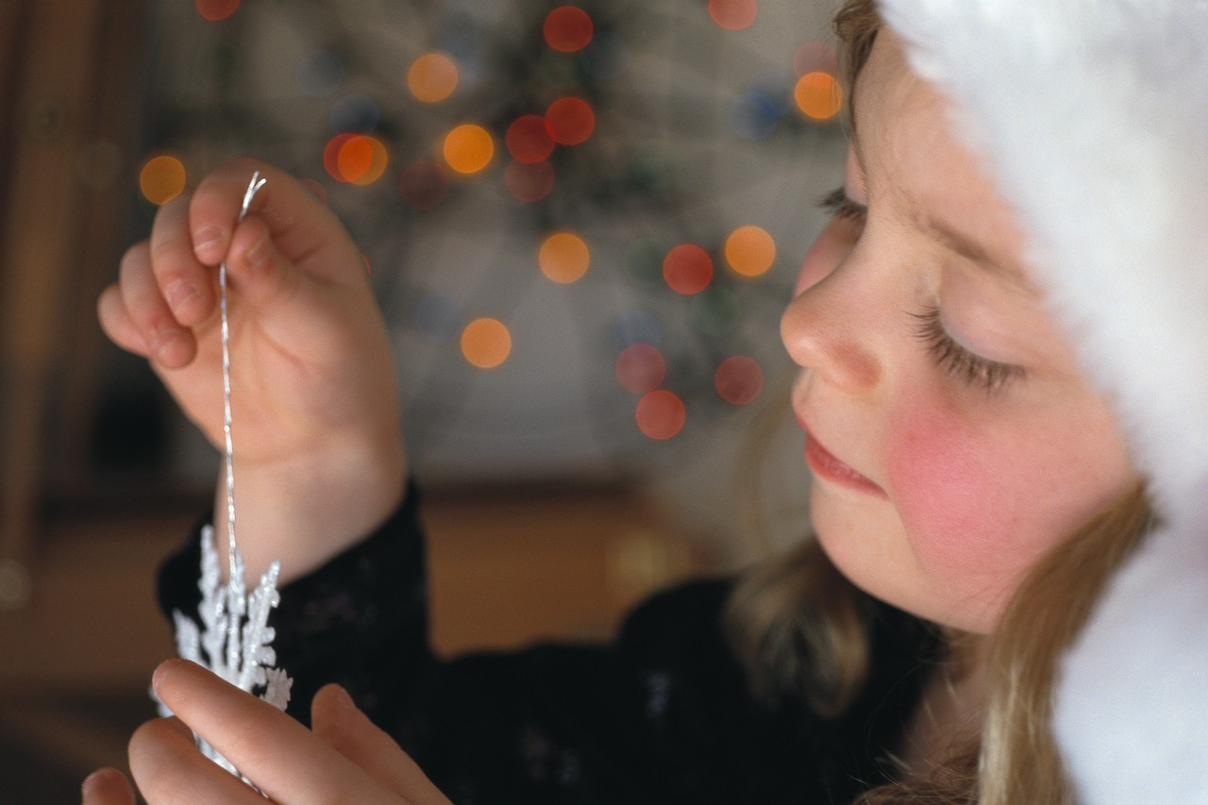
Inferences: Take One More Guess?
What season is it in this picture?
2. What is the person doing?
What socio-economic group does she belong to? Lower Class? Middle class? Upper Class?
{Click mouse to continue}

Slide 8
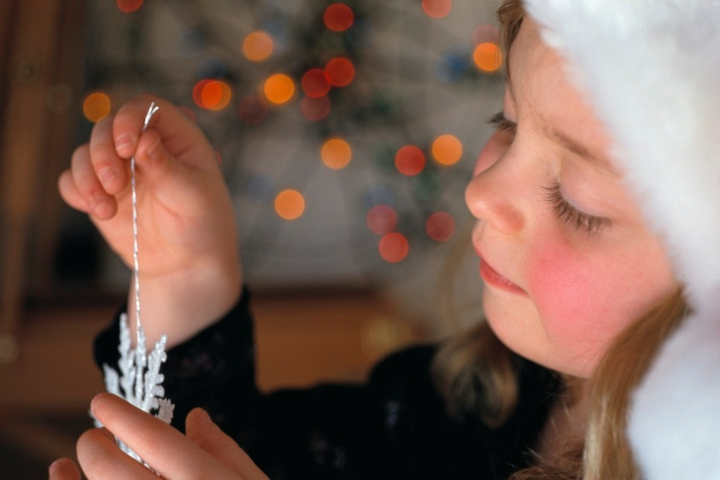
Inferences: Take a Guess?
What is the person doing?
Lets look a little bit closer and evaluate your assumptions.
She is holding the Ornament. We could infer further that she is decorating a Christmas tree.
What socio-economic group does she belong to?
Based on the quality of the clothing and ornament, we can rule out lower class. Based on the known information any further inference would be a stretch.
What season is it in this picture?
The Santa hat and Ornament reveal that it is winter.
{Click mouse to continue}

Slide 9
Inferences: The Setting
Read the following selection:
The air blowing off of the water is clean and crisp. As she slowly made her way to her destination, the damp sand beneath her feet began to stick to the bottom of her toes. Finally, she was close enough to see. A blue and white table cloth spread over the sand. Candles, crystal, and china glistened in the light of the setting sun. She smiled, and a tear ran down her cheek.
Where is this woman?
What time of day is it?
As she approaches, what does she see?
Will she be spending the evening alone?
{Click mouse to continue}

Slide 10
Inferences: The Setting
Where is this woman?
Based on the word picture painted for us, she is on the beach.
What time of day is it?
The air blowing off of the is clean and crisp. As she slowly made her way to her destination, the damp beneath her feet began to stick to the bottom of her toes. Finally, she was close enough to see. A blue and white spread over the sand. glistened in the light of the . She smiled , and a tear ran down her cheek.
water
It is evening.
Will she be spending the evening alone?
sand
We can logically assume that whomever has made the picnic will probably join her.
table cloth
Candles, crystal, and china
As she approaches, what does she see?
setting sun
That someone has prepared a picnic for her.
{Click mouse to continue}

Slide 11
Inferences: Character Personalities & Emotions
Author’s often use word pictures to give you clues about the personalities and emotions of the characters. For Instance:
If the character is shown refusing to be controlled by others such as their parents, boss, or other authority figure
We infer that they are rebellious.
If the character storms out of the room, slamming the door behind them
We infer that they are angry.
If we see them doing things that show good character in front of other, but exhibiting negative traits when alone
We infer that they are deceptive.
{Click mouse to continue}

Slide 12
Inferences: Character Personalities & Emotions
How does the woman feel about what this person has done?
With this in mind, lets take another look at the excerpt we read earlier.
Based on her smile and tears, we can assume she is happy and touched by the gesture.
The air blowing off of the water is clean and crisp. As she slowly made her way to her destination, the damp sand beneath her feet began to stick to the bottom of her toes. Finally, she was close enough to see. A blue and white table cloth spread over the sand. Candles, crystal, and china glistened in the light of the setting sun.
Though we have not been introduced to the person that has planned this, what can we assume about their personality?
We can assume that he is caring and thoughtful. Though this may or may not prove to be correct by the end of the story, that is the word picture the author has painted for us so far.
She smiled, and a tear ran down her cheek.
{Click mouse to continue}

Slide 13
Inferences: Character Motives
Why did he leave her a note?
We can infer that he left her a note to tell her to meet him on the beach.
Charles had been planning this for weeks. He had waited for an evening with clear skies and a soft breeze. He had laid out the tablecloth, placed the glasses and plates just right. For a few seconds, he wondered if she had found the note that he had left her, but soon he could see her slowly walking down the beach. As she approached, he took a deep breath, kneeled down on one knee, and pulled a small box from his pocket.
Why has Charles made this picnic for her?
To propose to her.
{Click mouse to continue}

Slide 14
Inferences: Writer’s Motives
All people have their own moral and political perspectives. Sometimes, these perspectives color what an author writes. This can take place in both fiction and nonfiction pieces.
Read the following and try to determine what this writer’s motives for writing this might be.
At the close of the year 1999, composting and recycling had stopped 64 million tons of material from ending up in landfills and incinerators (U.S. Environmental Protection Agency) . Though that is a good start, America has a long way to go. As a country, it is our responsibility to protect the environment for the sake of future generations!

Slide 15
Inferences: Writer’s Motives
Lets ask ourselves a few questions about this piece.
At the close of the year 1999, composting and recycling had stopped 64 million tons of material from ending up in landfills and incinerators (U.S. Environmental Protection Agency) . Though that is a , America has long way to go. As a country, it is to protect the environment for the sake of future generations!
good start
our responsibility
Do you think this is a fiction or nonfiction piece?
What motives does this writer have for writing this piece?
This is a nonfiction piece.
The writer is an environmentalist.
{Click mouse to continue}

Slide 16

Inferences: Take a Guess Part 2
Now that you know how to use what the text does say to figure out things that it does not,
Lets look at a few to practice your new skills!
Write your answers down as you go.

Slide 17
Inferences: Take a Guess Part 2
Read the following paragraph, and answer the questions that follow.
Geoffrey awoke early that morning, for fear of being late for his appointment. He showered, brushed his hair, and put on his best suit. He stuck extra ink pens and pencils into his brief case. He did not want to leave anything to chance. He knew that if he did not get a job soon, Martha would have to leave the children and go back to work.
{Click mouse to continue}

Slide 18
Inferences: Take a Guess Part 2
Geoffrey awoke early that morning, for fear of being late for his appointment. He showered, brushed his hair, and put on his best suit. He stuck extra ink pens and pencils into his brief case. He did not want to leave anything to chance. He knew that if he did not get a job soon, Martha would have to leave the children and go back to work.
What kind of appointment is Geoffrey getting ready for?
  He is going job hunting.
  He is going to a board meeting for his job.
  He is going to a job interview.
{Click mouse to continue}

Slide 19
Inferences: Take a Guess Part 2
Geoffrey awoke early that morning, for fear of being late for his appointment. He showered, brushed his hair, and put on his best suit. He stuck extra ink pens and pencils into his brief case. He did not want to leave anything to chance. He knew that if he did not get a job soon, Martha would have to leave the children and go back to work.
2. Who is Martha?
  His mother.
  His wife.
  His daughter.
{Click mouse to continue}

Slide 20
Inferences: Take a Guess Part 2
Geoffrey awoke early that morning, for fear of being late for his appointment. He showered, brushed his hair, and put on his best suit. He stuck extra ink pens and pencils into his brief case. He did not want to leave anything to chance. He knew that if he did not get a job soon, Martha would have to leave the children and go back to work.
3. Which of these personality traits best fits Geoffrey?
  Responsible
  Optimistic
  Selfish
{Click mouse to continue}

Slide 21
Inferences: Take a Guess Part 2
Geoffrey awoke early that morning, for fear of being late for his appointment. He showered, brushed his hair, and put on his best suit. He stuck extra ink pens and pencils into his brief case. He did not want to leave anything to chance. He knew that if he did not get a job soon, Martha would have to leave the children and go back to work.
4. What is Geoffrey’s motive for waking up early ?
  To be an example for his children.
  To be on time for his appointment.
  He does not want Martha to go back to work.
{Click mouse to continue}

Slide 22
Inferences: Take a Guess Part 2
Geoffrey awoke early that morning, for fear of being late for his appointment. He showered, brushed his hair, and put on his best suit. He stuck extra ink pens and pencils into his brief case. He did not want to leave anything to chance. He knew that if he did not get a job soon, Martha would have to leave the children and go back to work.
5. What might he need extra pens and pencils for at his appointment ?
  To fill out necessary forms.
  To take notes on the speaker.
  To hand out as advertisements for his firm.
{Click mouse to continue}

Slide 23
Inferences: Take a Guess Part 2
Now, lets go on to the next piece.
What kind of appointment is Geoffrey getting ready for?
  He is going job hunting.
  He is going to a board meeting for his job.
  c) He is going to a job interview.
The writer is suggesting that the appointment will solve this problem:
“He knew that if he did not get a job soon, Martha would have to leave the children and go back to work.”
We can assume that he is not going job hunting because that does not require an appointment.
{Click mouse to continue}

Slide 24
Inferences: Take a Guess Part 2
2. Who is Martha?
  His mother.
  c) His daughter.
  b) His wife.
“He knew that if he did not get a job soon, Martha would have to leave the children and go back to work. “
The same quote we used for the last question, suggests that Martha is the mother of his children and not his mother or his child.
{Click mouse to continue}

Slide 25
Inferences: Take a Guess Part 2
3. Which of these personality traits best fits Geoffrey?
  b) Optimistic
  c) Selfish
  Responsible
“Geoffrey awoke early that morning … He stuck extra ink pens and pencils into his brief case. He did not want to leave anything to chance.”
These words describe a man who is responsible. There are no suggestions that he is optimistic or selfish in the text.
{Click mouse to continue}

Slide 26
Inferences: Take a Guess Part 2
5. What might he need extra pens and pencils for at his appointment ?
  b) To take notes on the speaker.
  c) To hand out as advertisements for his firm.
  a) To fill out necessary forms.
Because we have established that Geoffrey is going to a job interview, we can infer that he needs these utensils to fill out the application or any other forms that they may give him
{Click mouse to continue}

